Slide 1
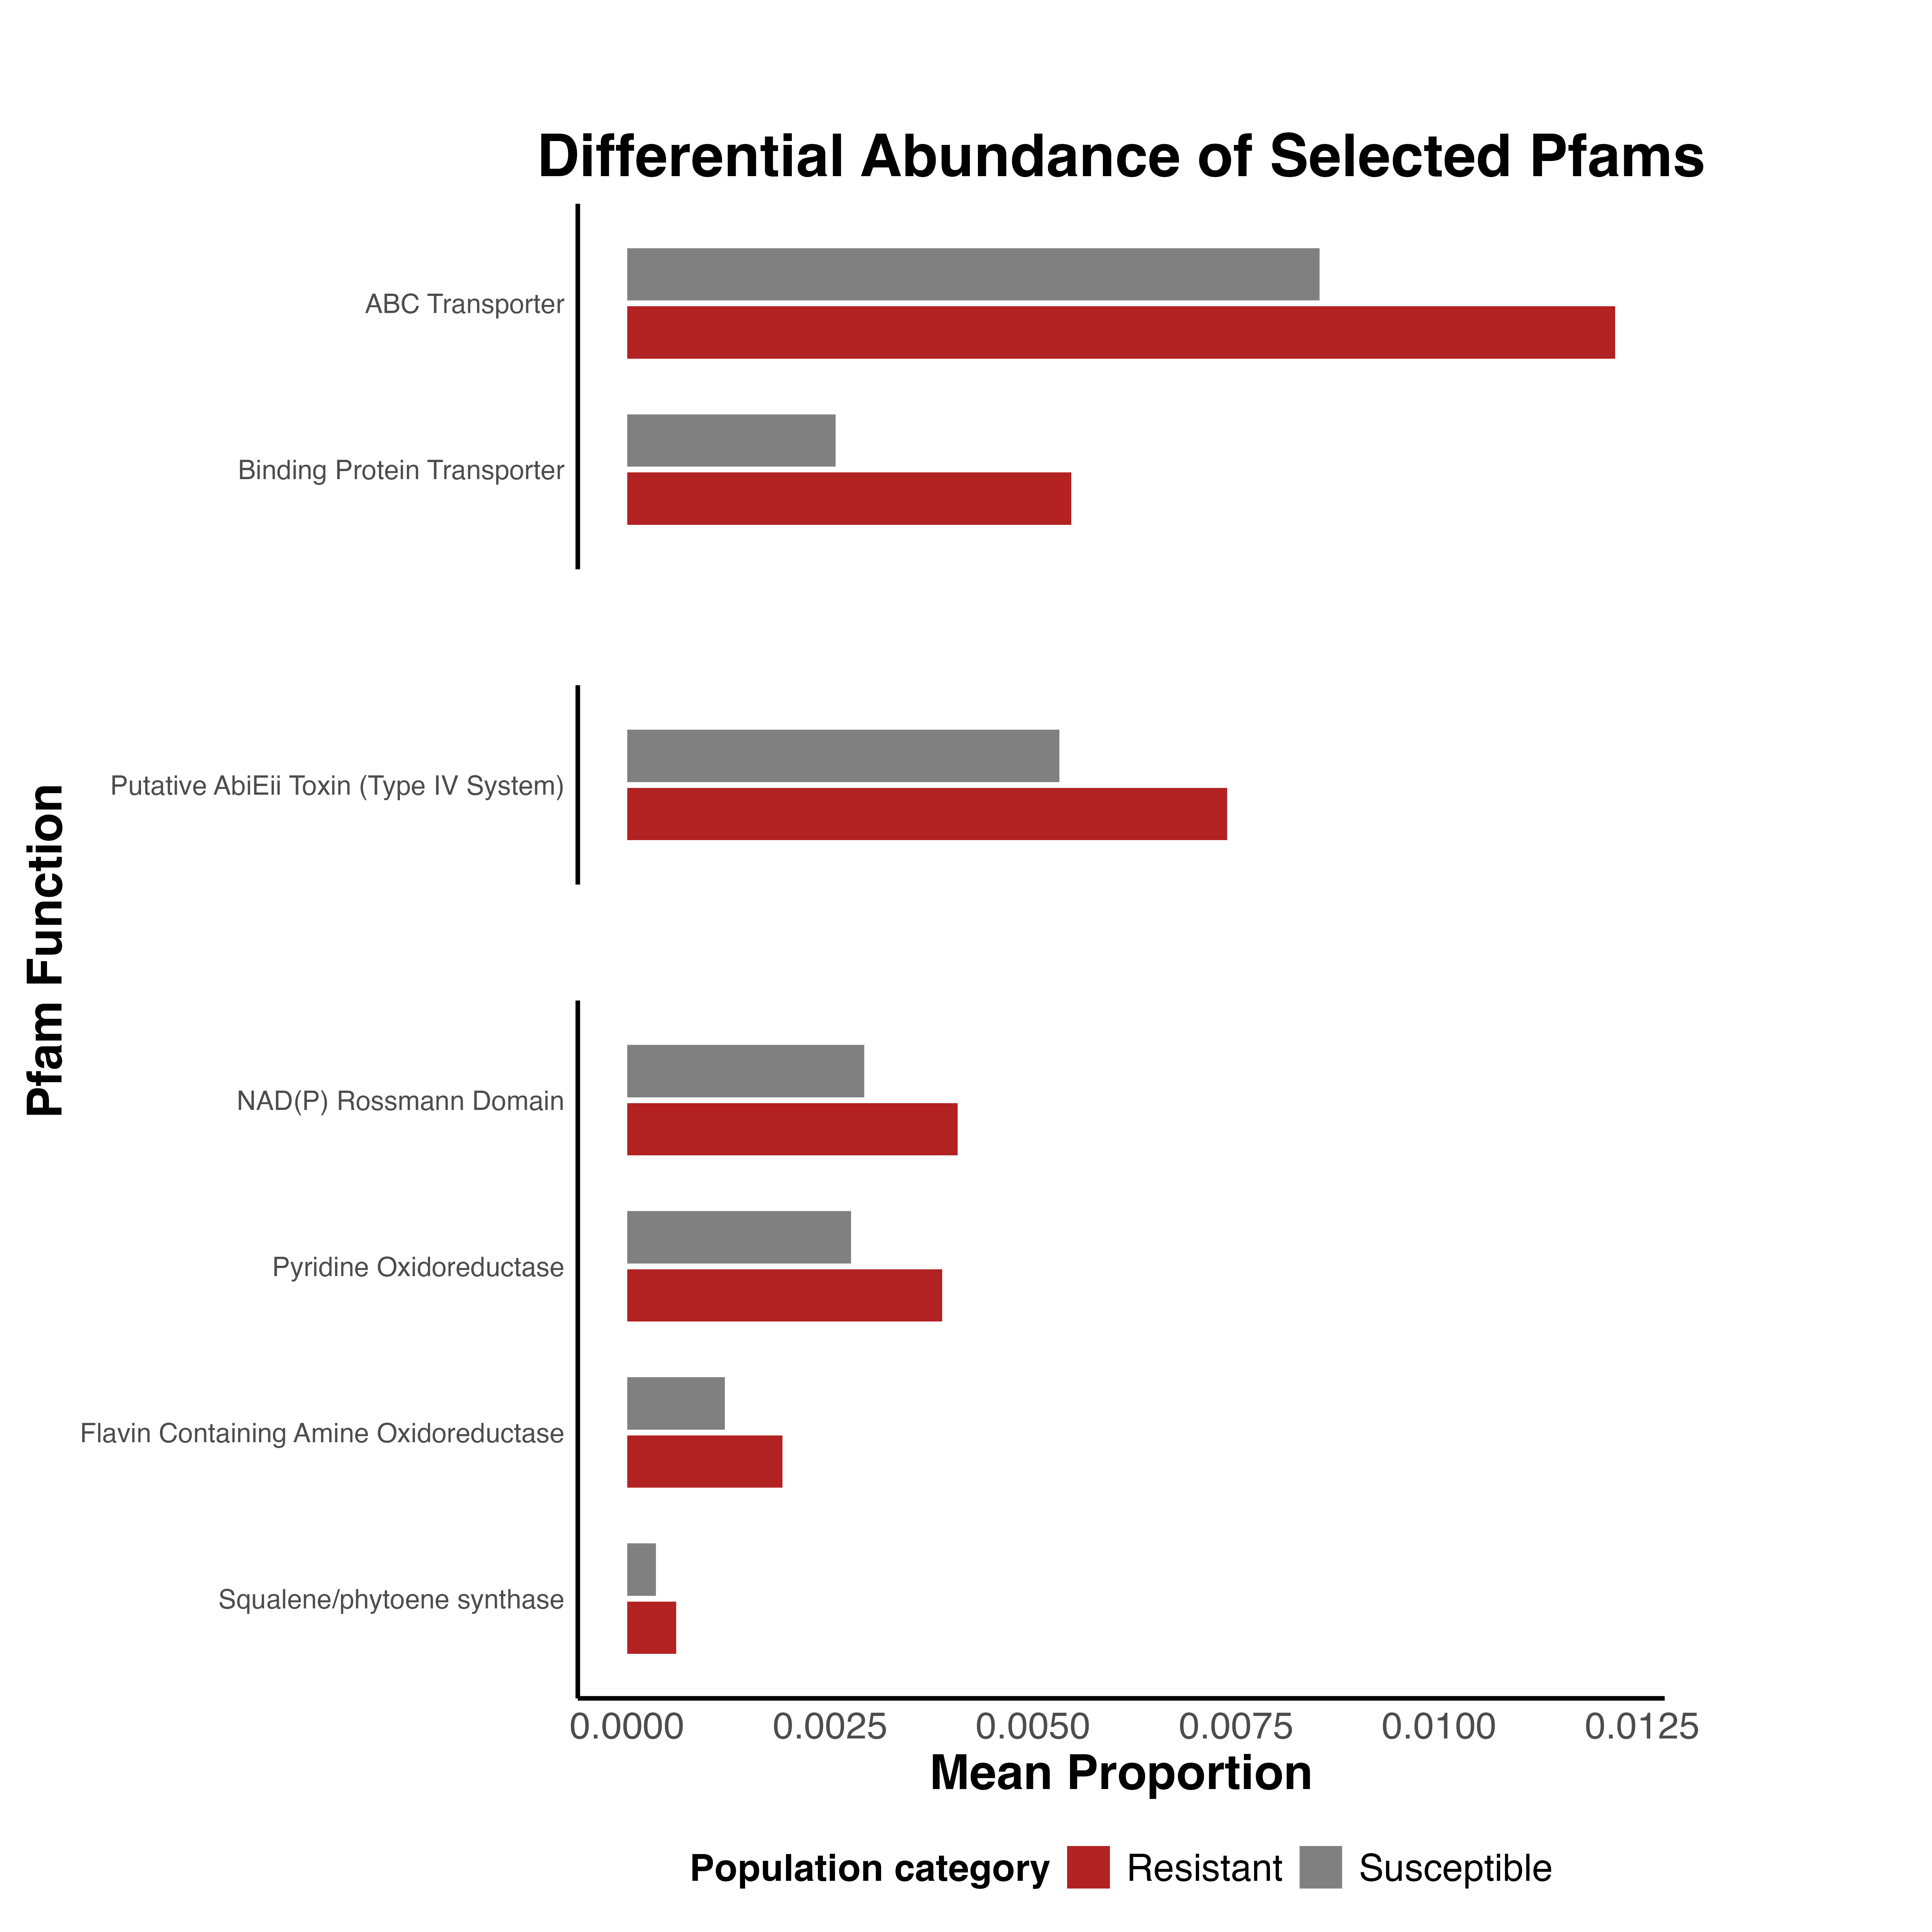
Transporters
Toxin-Antitoxin System
Oxidative Stress Response

Slide 2
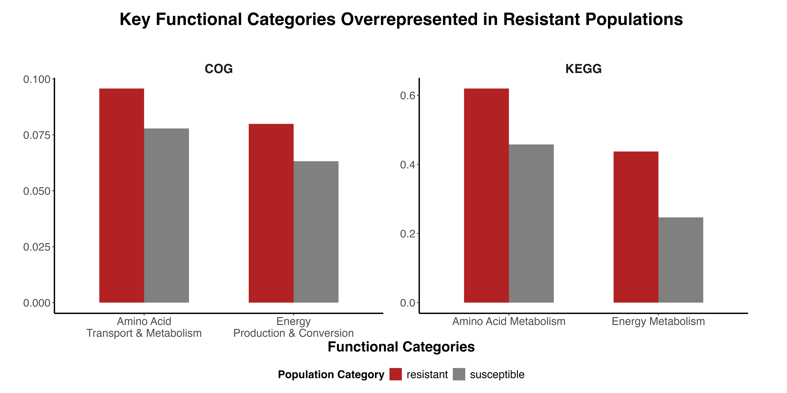
Relative Abundance
Mean completion

